Slide 1
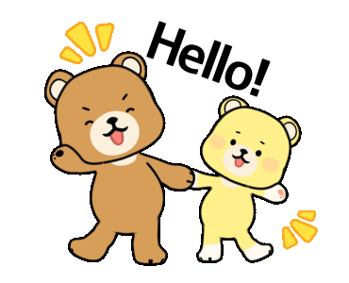
Hello!
Teacher: Camila

Slide 2


Hello! My name is Camila
(Hola! Mi nombre es Camila)
I am your teacher.
(Yo soy su profesora)
I am 25 years old.
(Tengo 25 años)

Slide 3
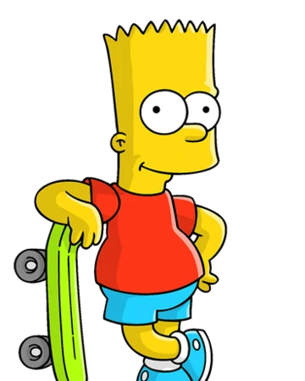
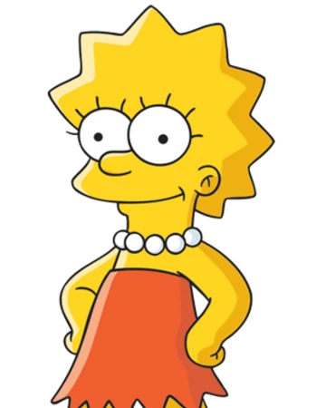
What is your name?
(¿Cuál es tu nombre?)
I am Bart!
(¡Yo soy Bart!)
My name is Lisa!
(Mi nombre es Lisa)

Slide 4
How old are you?
(¿Cuántos años tienes?)
I am 10 years old
(Yo tengo 10 años)
I am 8 years old
(Yo tengo 8 años)

Slide 5

What is your name?
How old are you?

Slide 6
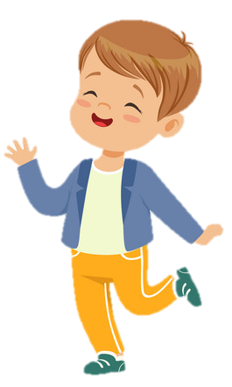
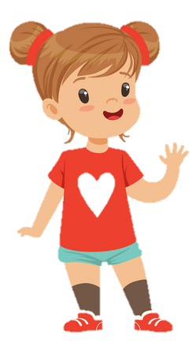
Greetings!
Good morning!
Hello!

Slide 7
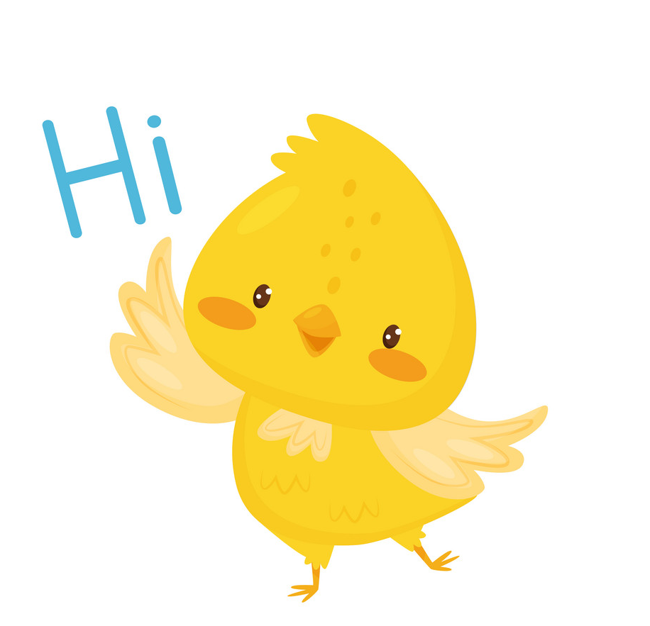
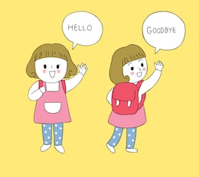
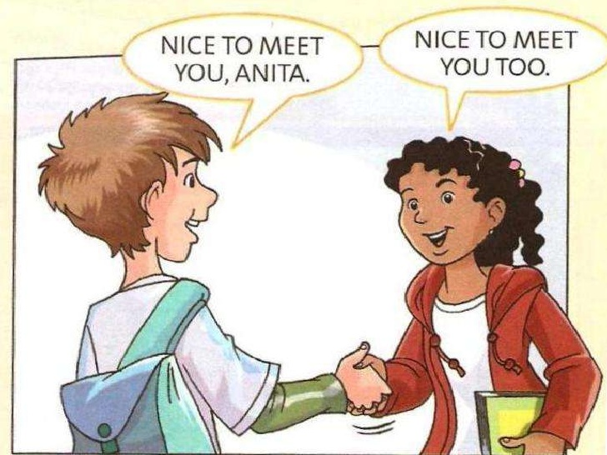
Saying Hi
(Diciendo Hola)
Hi or Hello (hola)
Good morning (buenos días), good afternoon (buenas tardes).
Saying Bye
(Diciendo Adiós)
Bye or Good bye (adiós)
See you (nos vemos)
Nice to meet you (fue un gusto conocerte)

Slide 8
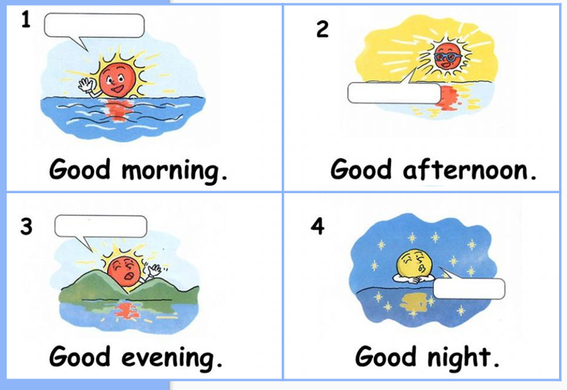
Buenos días
8:00 am
Buenas tardes
12:00 pm
Buenas tardes
6:00 pm
Buenas noches
10:00 pm

Slide 9

Amy: Hi! My name is Amy, what is your name?
Jake: Hi Amy, I’m Jake. How are you?
Amy: I’m fine, thanks. How are you?
Jake: I’m great!
Amy: Bye, Jake. Nice to meet you.
Jake: Nice to meet you too, Amy!

Slide 10
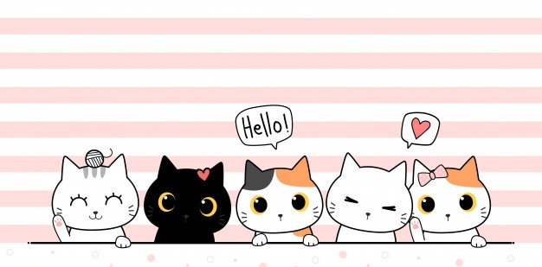
Now is your turn to practice in the worksheet!
(Ahora es tu turno de practicar en la guía)
SEE YOU

